Slide 1
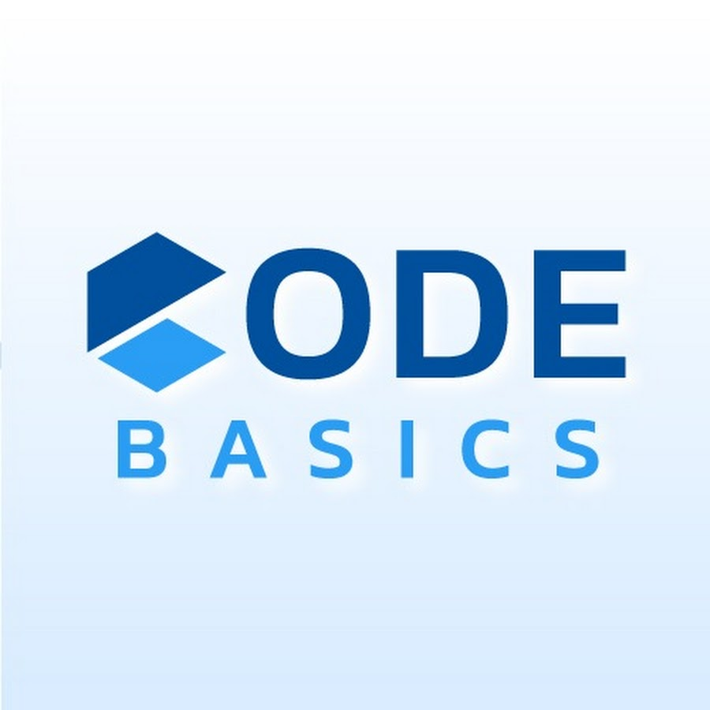

GoodCabs
From Doorstep to Destination

Slide 2
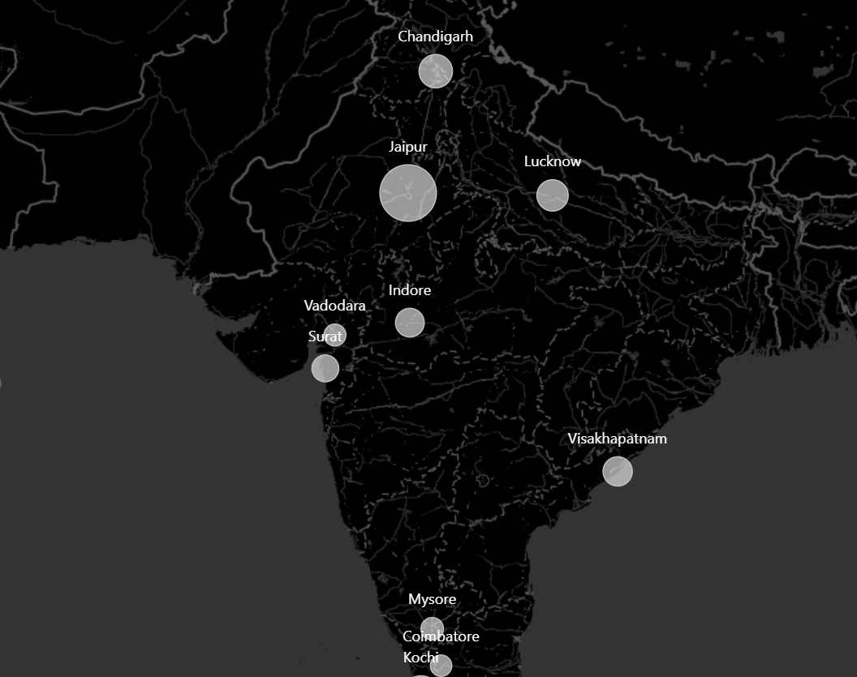
Goodcabs, a cab service company established two years ago, has gained a strong foothold in the Indian market by focusing on tier-2 cities. Unlike other cab service providers, Goodcabs is committed to supporting local drivers, helping them make a sustainable living in their hometowns while ensuring excellent service to passengers. With operations in ten tier -2 cities across India, Goodcabs has set ambitious performance targets for 2024 to drive growth and improve passenger satisfaction. As part of this initiative, the Goodcabs management team aims to assess the company s performance across key metrics, including trip volume, passenger satisfaction, repeat passenger rate, trip distribution, and the balance between new and repeat passengers

Slide 3

Ad-hoc Business Requests

Slide 4
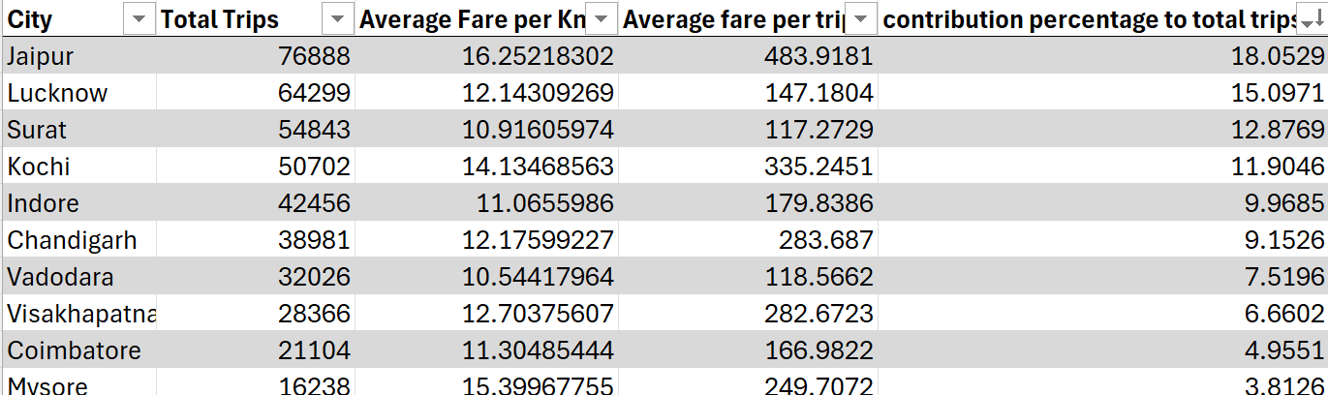
City level fare and trip summary report

Slide 5
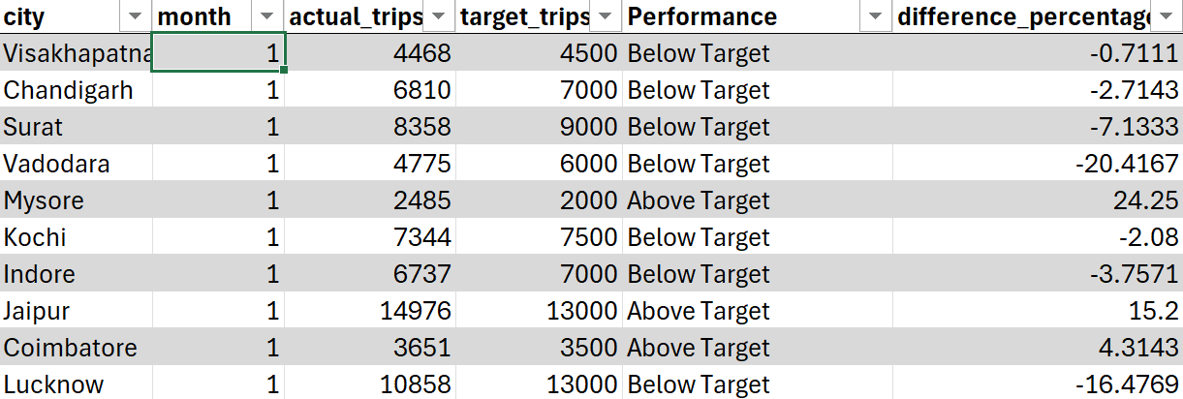
Monthly city-level target performance

Slide 6
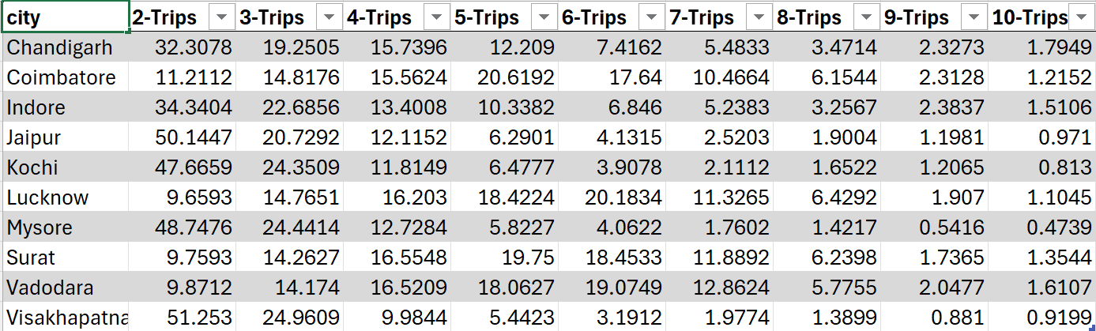
City-level repeat passengers

Slide 7
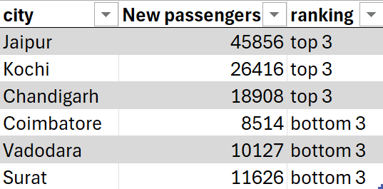
Top and bottom 3 cities with new passeng

Slide 8
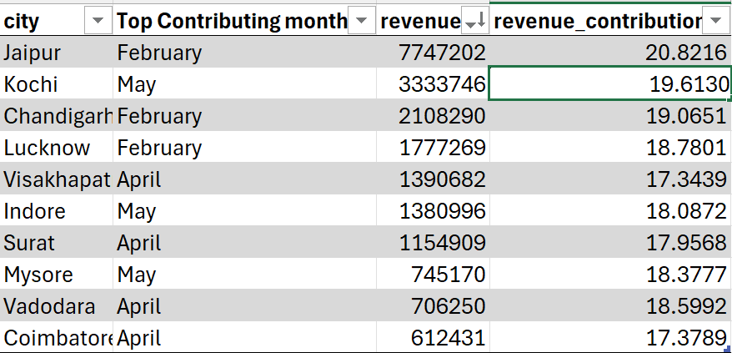
Month with highest revenue for each city

Slide 9
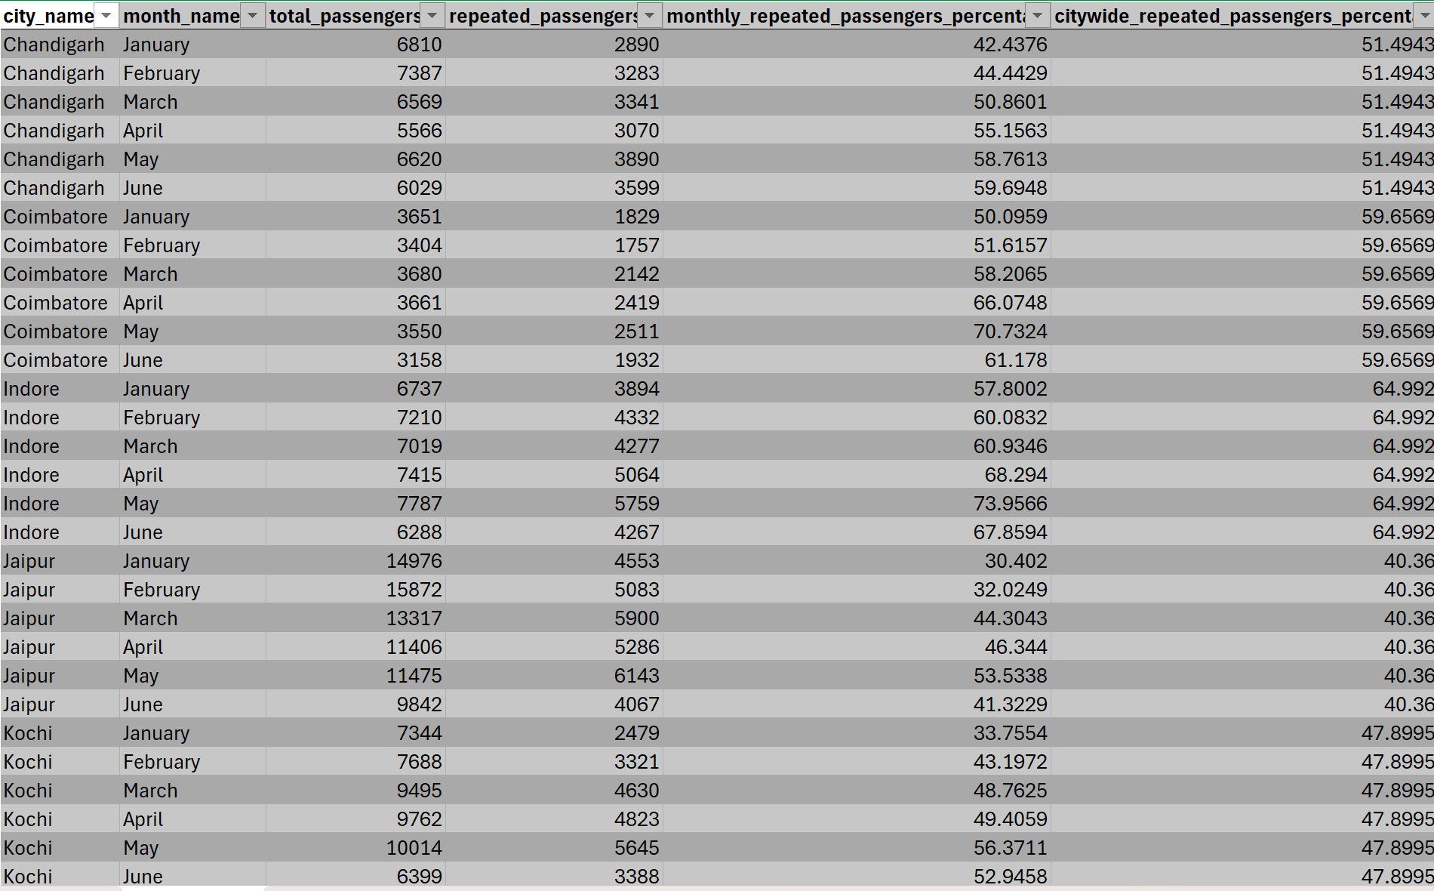
Repeat Passenger rate analysis

Slide 11

Primary Analysis

Slide 12
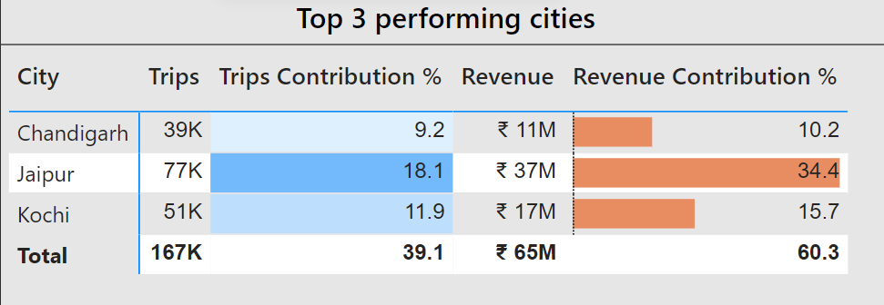
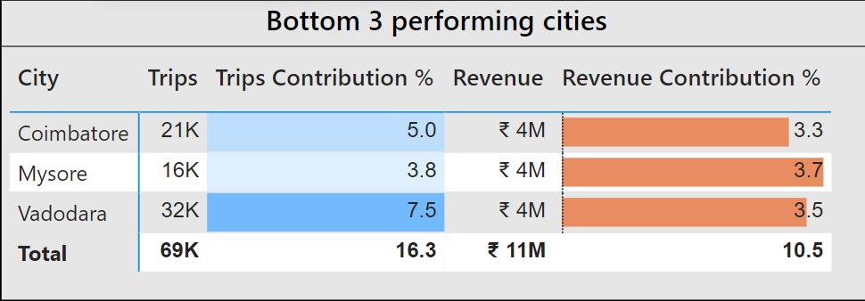
Top and bottom 3 performing cities

Slide 13
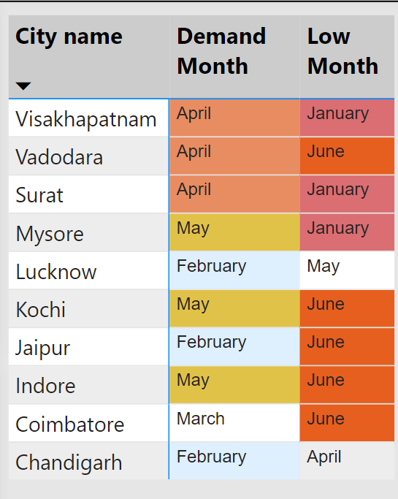
Peak and Low demand Month for each City

Slide 14
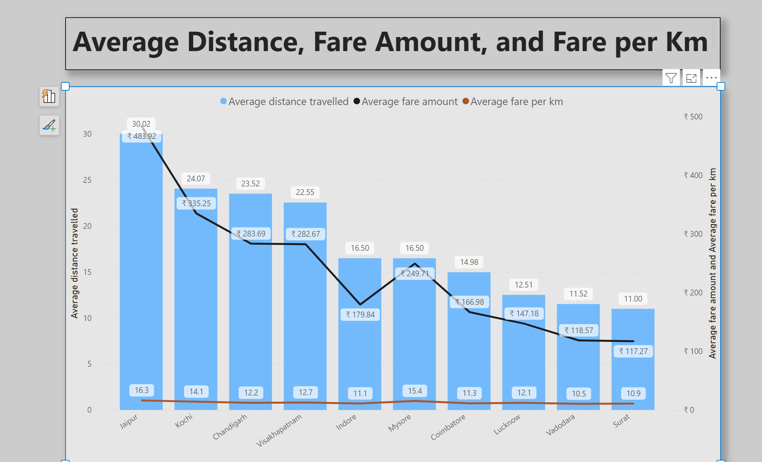

Slide 15
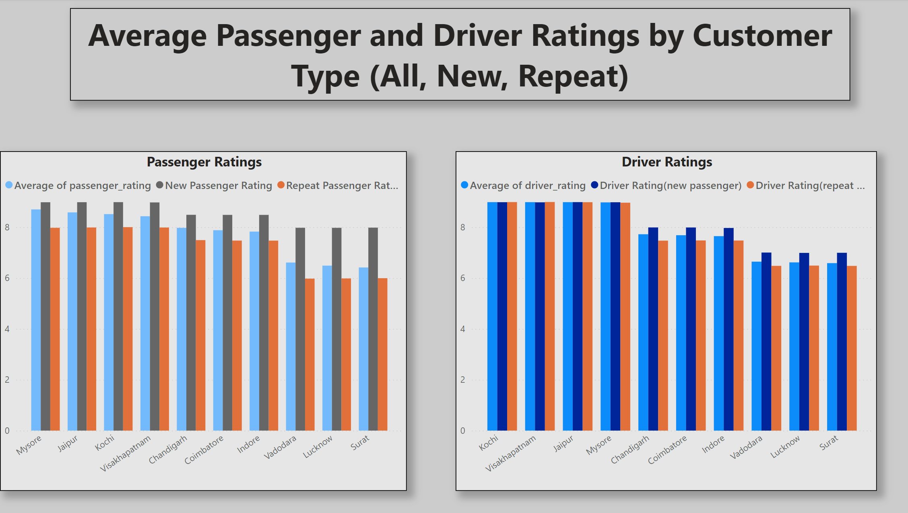
Average Passenger and Driver Rating

Slide 16
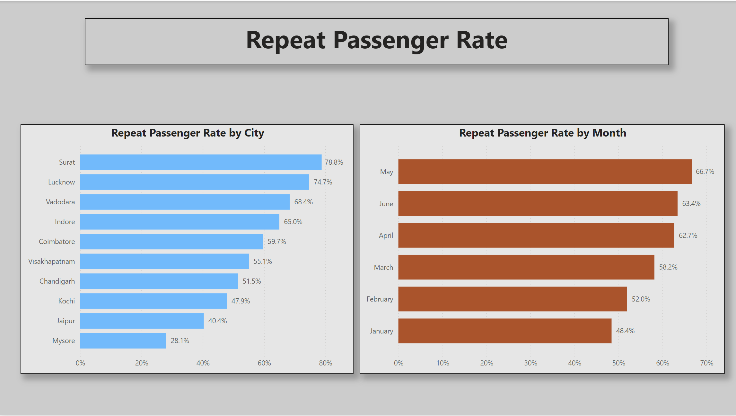

Slide 17
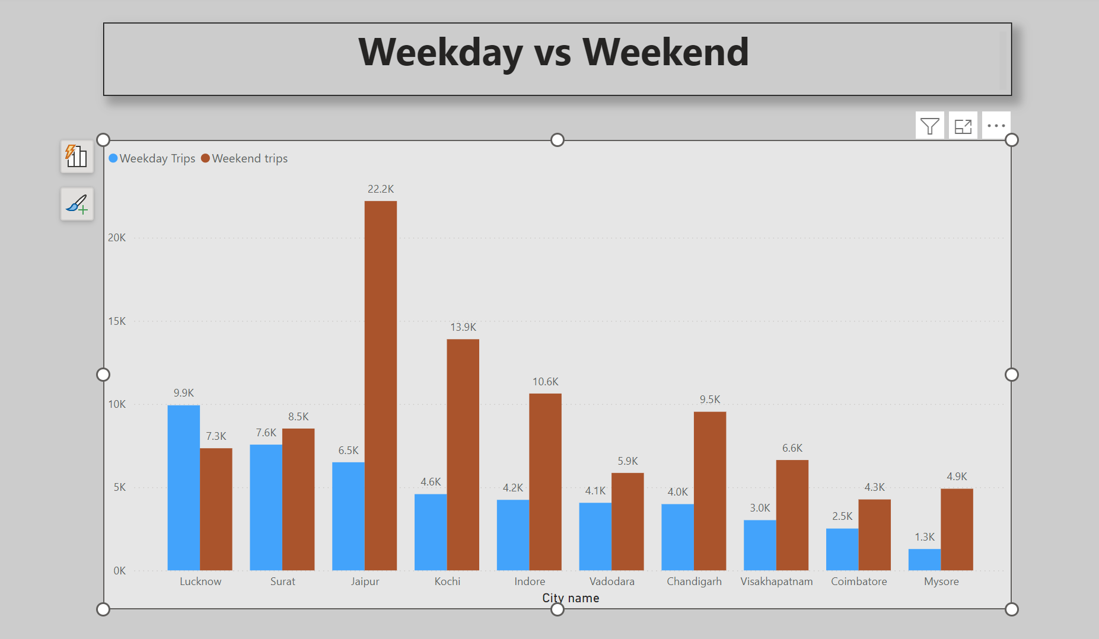

Slide 18
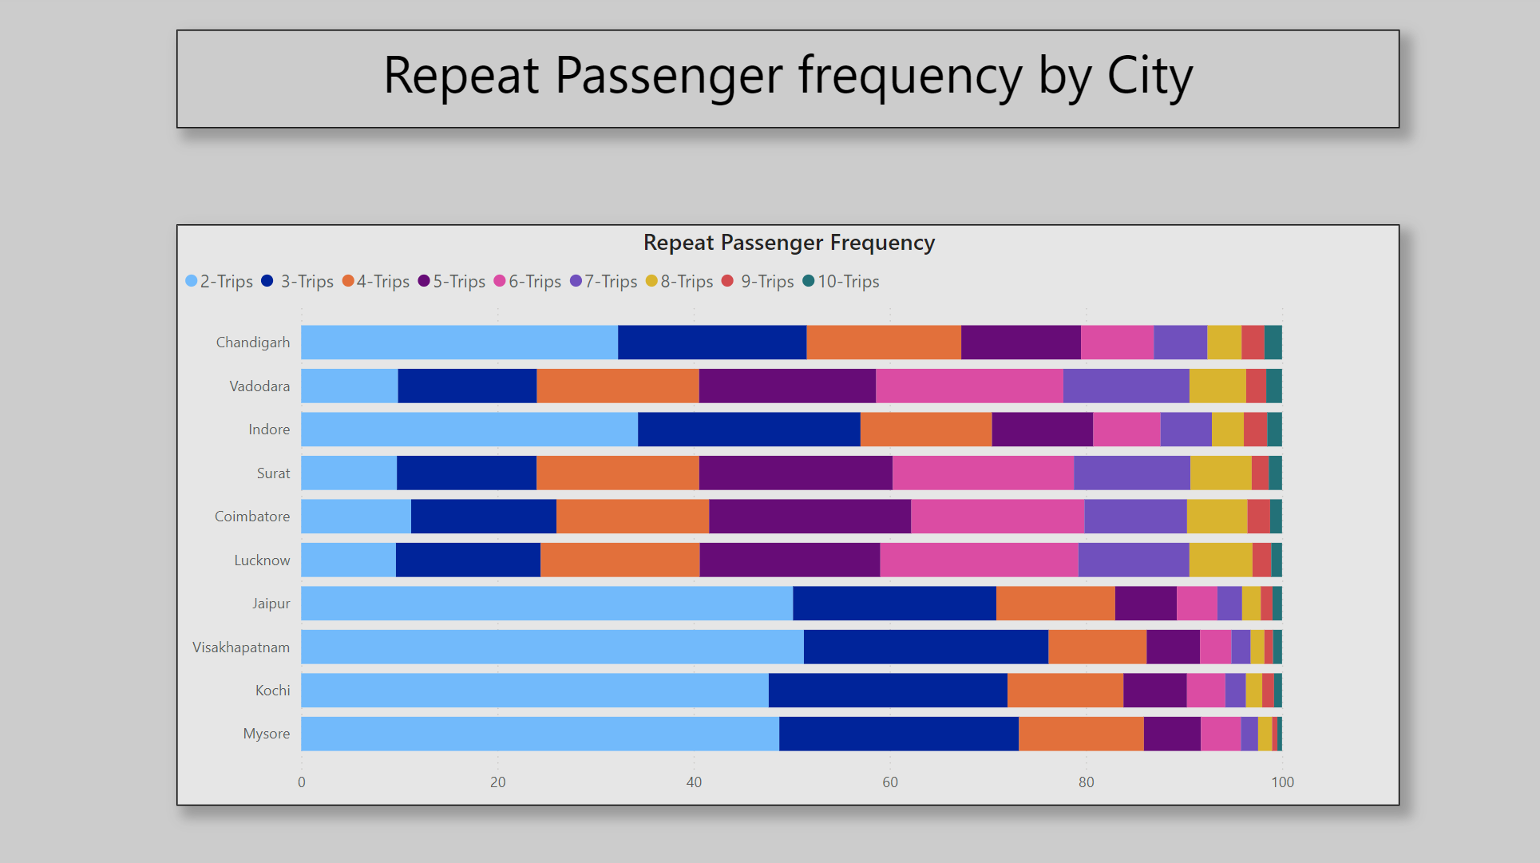

Slide 20
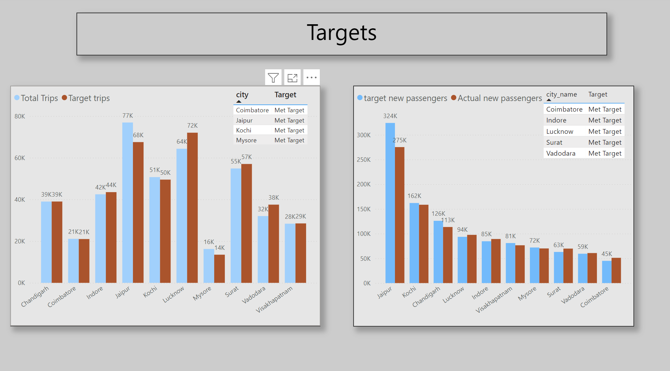

Slide 21
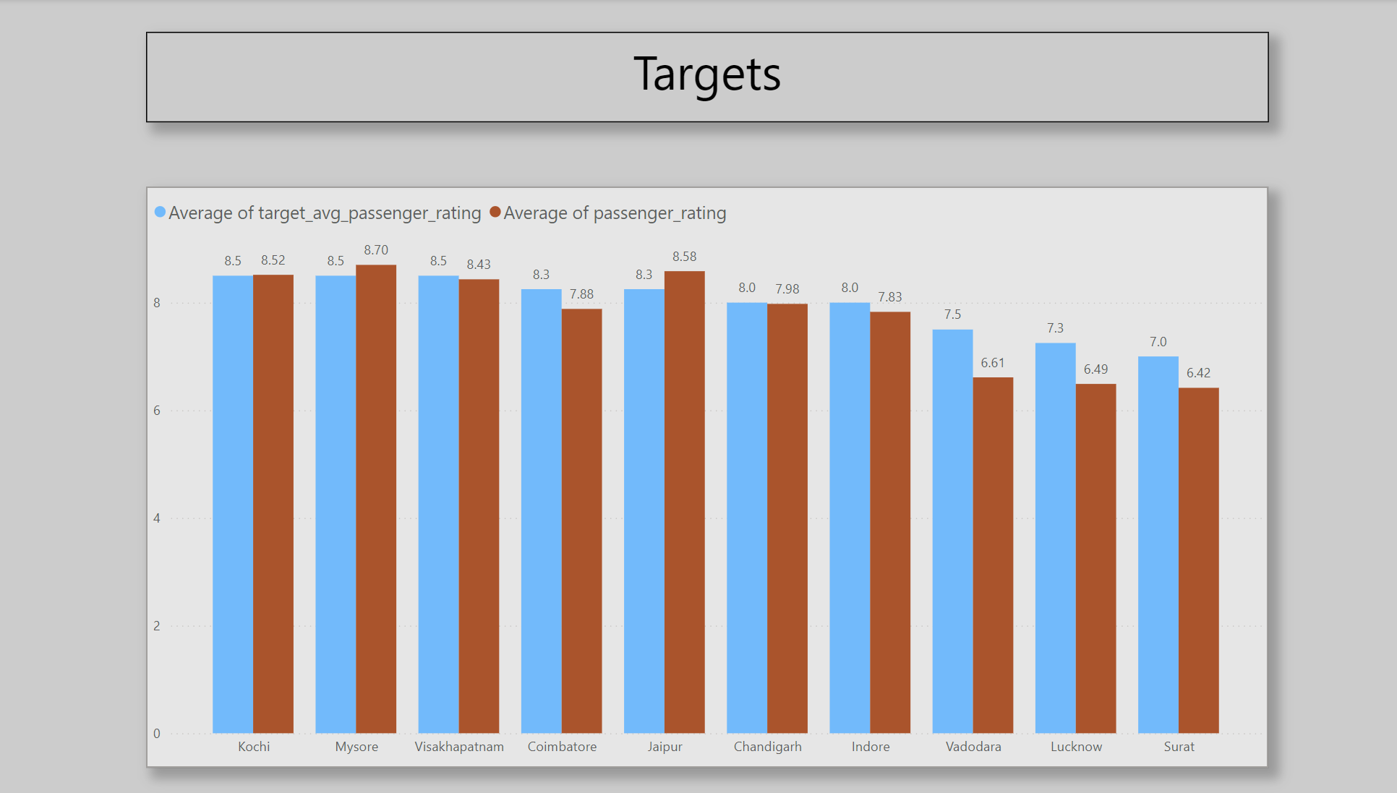

Slide 22


Slide 23
Recommendations

Slide 24
Tourism Cities: Jaipur, Kochi, Chandigarh, Mysore, Lucknow

Slide 25
Maximize Weekend and Seasonal Demand
Weekend Packages & Discounts:
Targeted Offers: Launch weekend promotions such as discounts or special packages for tourists visiting key attractions (e.g., forts in Jaipur, backwaters in Kochi, Mysore Palace).
Group Bookings: Offer group booking discounts for families or tourist groups visiting popular destinations, incentivizing larger bookings.
Seasonal Pricing: Adjust pricing during peak tourist seasons (e.g., festivals, holidays) to optimize revenue. Implement dynamic pricing that scales with demand, especially during major events and peak tourist seasons.
Collaborate with Local Tourism Bodies:
Partner with tourism boards and hotels to increase visibility and promote your services as part of tour packages. For example, offer shuttle services to popular tourist spots or arrange special transport for tourists attending events or festivals.

Slide 26
Enhance Repeat Customer Engagement
Loyalty Programs:
Develop loyalty programs that reward frequent tourists or business travelers, offering discounts or incentives for repeat use of the service. For example, a "tourist card" that offers discounted or priority rides to popular tourist spots.
Targeted Promotions for Returning Visitors:
Introduce referral programs where tourists who have previously visited can refer others, earning discounts or special offers for future trips. This could be especially valuable in cities like Jaipur and Kochi, where repeat tourists visit for festivals or annual events.

Slide 27
Optimize Fleet for Fluctuating Demand
Seasonal Fleet Management:
Increase fleet availability during peak seasons, such as festivals or tourist peak months, and ensure that drivers are incentivized to work during high-demand periods like weekends, holidays, and special events.
For cities like Jaipur and Kochi, where demand surges during peak tourist seasons, ensure sufficient fleet availability by incentivizing drivers for high-demand days, ensuring that tourists can always access transportation.
Incentives for Weekend Availability:
Offer bonuses or surge pricing for drivers working during the weekends or holiday seasons. This can ensure that the fleet is always available when demand peaks, especially for tourists traveling to cultural or historical sites

Slide 28
Leverage Local Events and Festivals
Event-Based Marketing:
Promote transportation services around major local events or festivals like Jaipur's Kite Festival, Lucknow's Diwali celebrations, or Mysore's Dussehra festivities. Special event-based packages (e.g., transport to/from festival venues, temple visits) can attract more tourists and increase ride frequency.
Exclusive Event Packages:
Develop exclusive packages for tourists attending local events or cultural festivals. For example, create bundled services that include transport to Mysore's royal palace and nearby cultural events or organize rides for tourists attending Kochi's Onam festival.

Slide 29
Enhance Customer Experience for Tourists
Driver Training and Engagement:
Focus on improving the customer experience by training drivers to offer helpful information about local attractions, restaurants, and culture. This will elevate the overall experience for tourists and may encourage repeat business.
Provide incentives for drivers to maintain high ratings and improve customer satisfaction, especially for tourists looking for a comfortable and informative ride.
Language and Cultural Sensitivity:
Ensure that drivers are trained to cater to international tourists, with basic knowledge of popular tourist spots and the ability to offer services in multiple languages. This can improve the experience for foreign visitors, particularly in cities like Jaipur and Lucknow, which attract international tourists.

Slide 30
Focus on Efficient Booking Systems for Tourists
Easy Booking Options:
Ensure that booking systems are user-friendly for both local and international tourists. Consider integrating multi-language support or offering cashless options for tourists who may not be familiar with local payment methods.
Implement easy-to-use apps and features like pre-booking or ride scheduling to cater to tourists who plan their trips in advance.

Slide 31
For tourism-heavy cities like Jaipur, Kochi, Mysore, Lucknow, and Chandigarh, focusing on seasonal demand, repeat customer retention, event-based promotions, and customer experience is crucial to increasing market share. Developing partnerships with local businesses, focusing on eco-friendly travel, and optimizing fleet management during peak tourist seasons will help these cities fully leverage their tourism potential and ensure consistent growth.

Slide 32
Business-Heavy Cities: Surat, Vadodara, Indore, Coimbatore, and Chandigarh

Slide 33
Cater to Consistent Weekday Demand
Corporate Partnerships & Subscription Models:
Offer Corporate Packages: Build relationships with local companies to offer transportation services to their employees. Provide discounts for regular or bulk bookings, encouraging businesses to sign up for subscription-based services or employee transport programs.
Corporate Travel Subscriptions: Introduce a subscription model where businesses can pay for employees' daily commutes, providing them with a set number of rides per month. This ensures predictable, long-term demand.
Custom Packages for Professionals:
Tailor services specifically for business professionals, offering rides that align with work hours and peak office times. You can offer premium services, such as dedicated rides to and from corporate hubs or meeting locations.

Slide 34
Optimize Fleet for Regular and High-Traffic Work Hours
Fleet Management During Peak Work Hours:
In business-heavy cities, focus on optimizing your fleet during peak commuting hours (morning and evening rush hours). Ensure that vehicles are available and drivers are incentivized to work during these high-demand times, especially on weekdays.
Increase Fleet for Corporate Hubs: Increase the number of vehicles available near corporate centers and offices to meet the high demand during work hours. Cities like Surat, Vadodara, and Chandigarh have a high concentration of business hubs, which could be prime locations for placing additional vehicles.
Ensure Availability During Weekdays:
Business travelers typically have a more predictable schedule. Consider creating flexible packages for professionals that cater to specific office hours (e.g., early morning rides, late-evening transport). This can help ensure that demand is met efficiently.

Slide 35
Improve Service Efficiency for Professionals
Faster Pickup and Drop-off Times:
Speed and convenience are crucial for professionals who need to be punctual. Ensure that the app or booking system offers quick, reliable pickup and drop-off options, with minimal waiting times.
Introduce features like "express pick-up" for professionals who need to get to meetings or conferences urgently.
Premium and Executive Services:
Consider offering premium or executive services, especially for business professionals who may prefer higher comfort levels (luxury cars, quiet rides, Wi-Fi availability, etc.). These services can be marketed to executives, consultants, or traveling business teams who are willing to pay extra for added comfort.
A more exclusive, business-focused experience (e.g., tailored in-ride amenities like charging ports, quiet environments) can cater to professionals’ needs during commutes.

Slide 36
Implement Efficient Transport Systems for Daily Commuters
Ride-Sharing Options for Daily Commuters:
Develop carpooling or ride-sharing options for employees in business-heavy cities. Many professionals commute on similar routes, so offering shared rides for these commutes can reduce the cost for employees and optimize fleet utilization for your business.
Focus on reducing commuting costs while maintaining the reliability and punctuality of service to meet the strict schedules of business professionals.

Slide 37
Promote Workplace Wellness and Comfort
Health & Safety Standards:
Highlight the safety and comfort features of your service. During times of heightened awareness (e.g., post-pandemic), emphasize measures like regular sanitization, driver health checks, and air purifiers inside vehicles.
Offer a premium, health-conscious ride experience, which can be a strong selling point for business clients looking for safe and hygienic travel options.

Slide 38
Efficient Marketing & Visibility in Business Areas
Targeted Marketing in Business Districts:
Use targeted marketing strategies to reach out to professionals in business districts, industrial areas, and corporate centers. This could include advertising through local business networks, partnerships with coworking spaces, or direct marketing to offices.
App and Service Visibility:
Ensure that your mobile app or service platform is user-friendly for business professionals. Ensure it's available for both iOS and Android users, with easy-to-use features for quick bookings, expense tracking, and real-time ride updates.

Slide 39
In business-heavy cities like Surat, Vadodara, Indore, Coimbatore, and Chandigarh, your focus should be on optimizing for consistency, corporate demand, and high-frequency weekday use. Offering tailored solutions for corporate clients, streamlining business commute services, and introducing features like loyalty programs, corporate accounts, and efficient fleet management are all key strategies to ensure growth. Additionally, positioning your services as reliable, professional, and comfortable can enhance appeal to business professionals who value time and convenience.

